Slide 1

Letterboxing
101
GSACPC

Slide 2
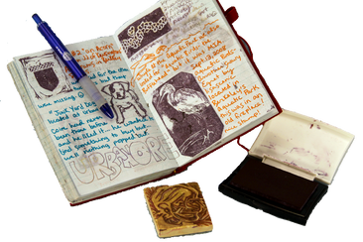
What is Letterboxing
Letterboxing combines artistic ability with "treasure-hunts" in parks, forests, and cities around the world. Participants seek out hidden letterboxes by cracking codes and following clues. The prize: an image from a miniature piece of art known as a rubber stamp—usually a unique, hand-carved creation.
Letterboxers stamp their discoveries in a personal journal, then use their own rubber stamp, called a signature stamp, to stamp into the letterbox’s logbook.

Slide 3
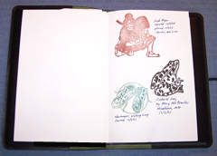
To Start Collecting Letterbox Stamps
Collect Your Supplies:
Signature stamp – representing you
Ink pads (different colors is fun) you might need a baby wipe to clean your stamp if you use different color pads
Log Book or index cards
Pen
Compass - if you choose to look for letterboxes with compass clues
Camera (on your phone) – optional but fun to record your adventures
Notes:
Getting Started Finding Letterboxes
1. Trail Name
A trail name is your letterboxing identity. Some letterboxers chose to use their real name, but most chose a trail name that is means something special to them. Examples of trail names are Mark & Sue, The Drew Clan, Team Green Dragon, The Wild Cats, Silent Doug, Clueless, and Choi.
Be Stealth - Try to approach the letterbox when other people won’t see you finding the letterbox. Otherwise, people that don’t appreciate the hobby may find it and throw it away.
Put the Letterbox back as close to where you found it as possible for the next quest.

Slide 4
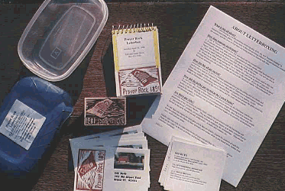
Supplies Needed to Place a Letterbox
A Stamp
make or purchase a rubber stamp that is meaningful to you or connects to the location of the letterbox.
Log Book
small notebook, preferably with no lines that fits in the weatherproof box
A Waterproof Container
Place a label on it with the name of the Letterbox and a note, “please do not throw it away if found”
Choose a location convenient to you. A favorite park or hiking trail. Write down clear instructions of where to park, location to start and as many directional clues as you can to direct the seeker.

Slide 5
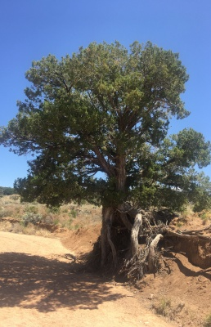
How to Find Letterboxes
https://www.letterboxing.org/
https://www.atlasquest.com/
To post a letterbox you will need to create a login at each of these sites.
Notes:
You can Search for a letterbox by city, State or advanced searches like drive-by, handicap accessible, Dog friendly, distance.
I like to print out the instructions before I go.
Each letterbox has the date it was posted and sometimes date last found.

Slide 6
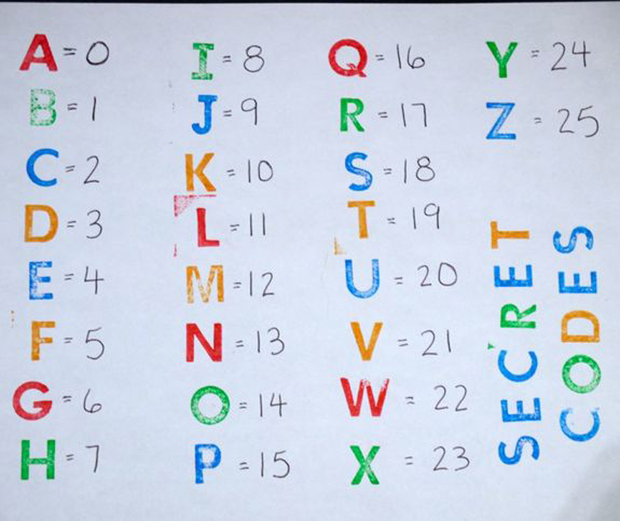
Ideas to Make Your Letterbox Unique
Carve your Own Stamp
Create fun clues to find your box, such as:
  Fill in the blank clues.
  Look ____the slide at the park (Question – What is the opposite of over?)
  Number code clues.
  Each number in the hint becomes a letter!

Slide 7


Remember, this is for Girl Scouts!
Choose locations and clues for all age groups.

